Slide 1
Stakeholder Mapping
How to identify the most important and influential Stakeholders and their Connections

Slide 2
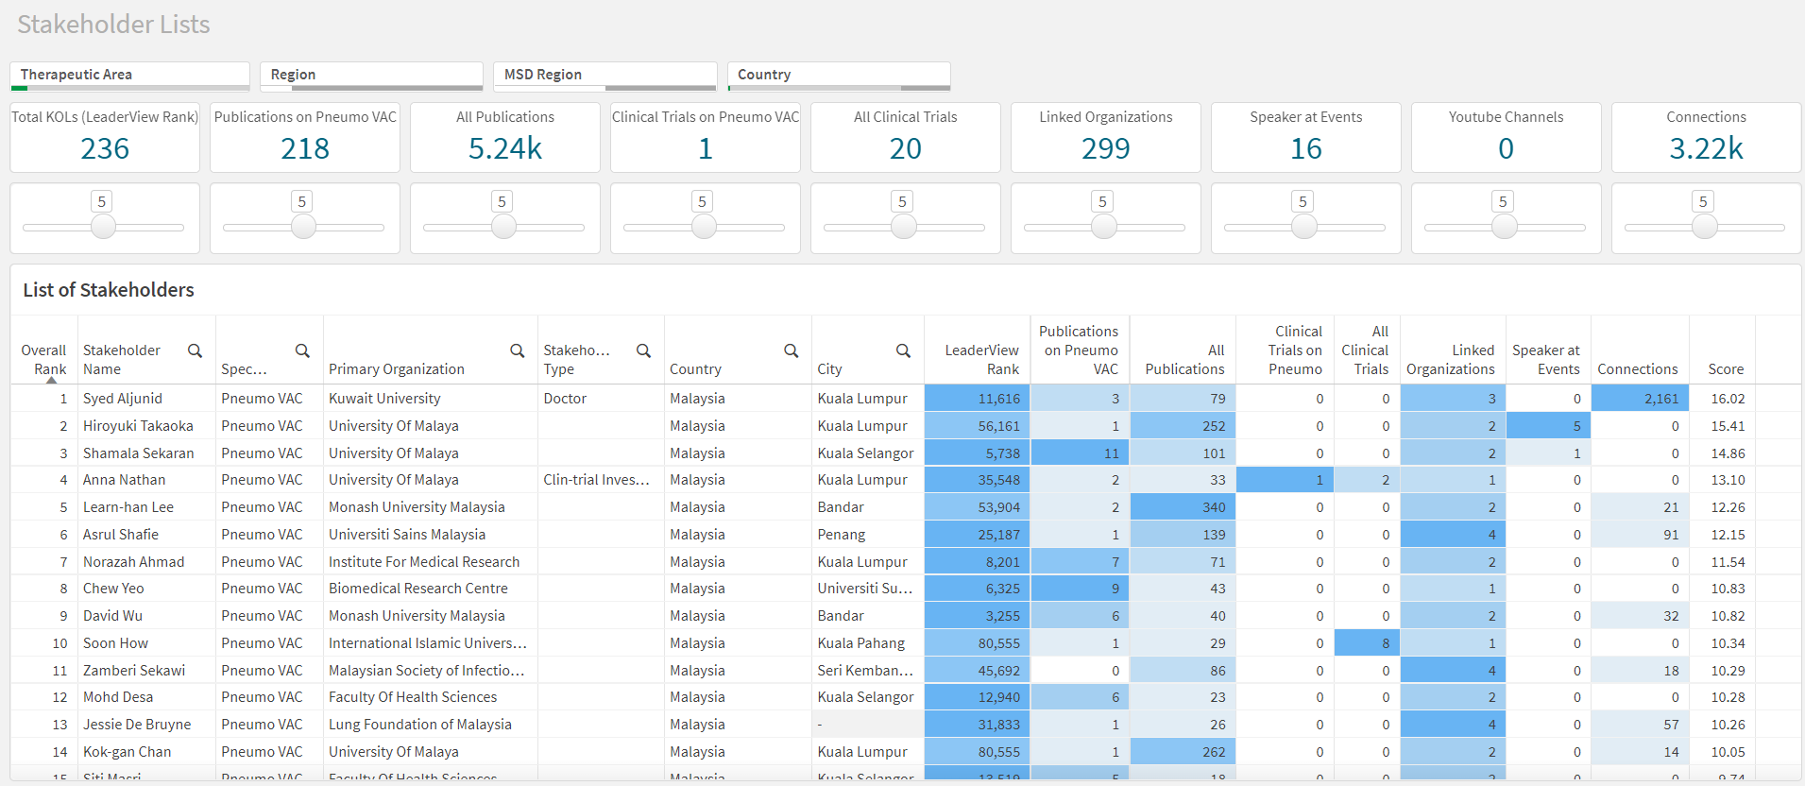
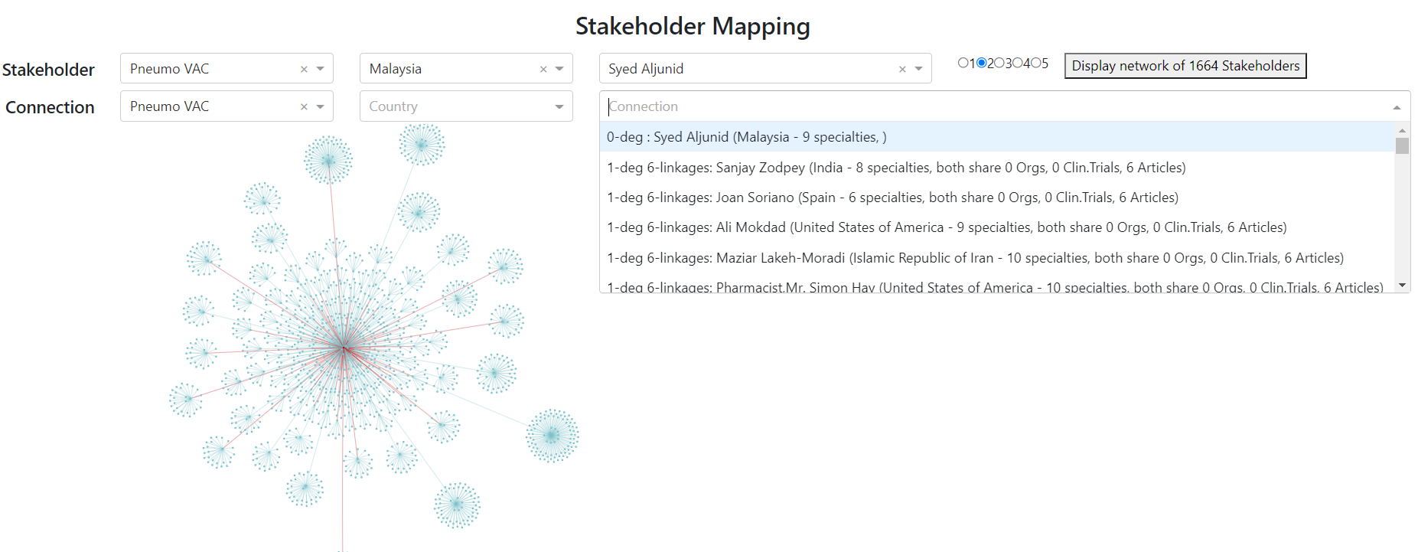
Introduction
There are 2 apps, the QlikSense Stakeholder Mapping and Plotly Dash Network tool. Use them hand in hand to identify important and influential stakeholders in a field and country.
QlikSense Stakeholder Mapping tool identifies most important stakeholders by their individual contributions.
Plotly Dash Network tool identifies most influential stakeholders by their connections.

Slide 3
QlikSense Stakeholder Mapping Tool

Slide 4
Which Stakeholder has the greatest contribution in Pneumo VAC in Malaysia?
1
2
Syed Aljunid is highest ranking Stakeholder with the most dark blue shaded contributions.
Select Pneumo VAC as Therapeutic Area.
Select Malaysia as Country.
Stakeholders are ranked from highest to lowest score, where the score is a sum of the weighted contributions.
The cells are shaded blue and is darkest when the Stakeholder has the highest value in that column of contribution.

Slide 5
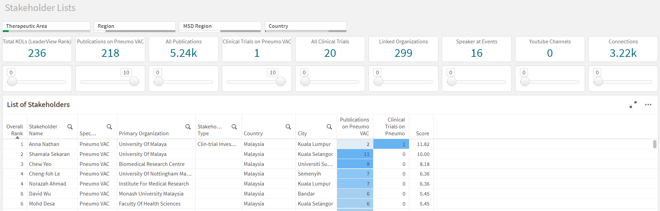
How can I give importance to only Publications and Clinical Trials in Pneumo Vac?
Set weights of Publications on Pneumo VAC and Clinical Trials on Pneumo VAC to 10, and all others to 0.
Now Anna Nathan is the Stakeholder with the highest contribution, with 2 Publications and involved in a Clinical Trial where nobody else has in Malaysia.

Slide 6
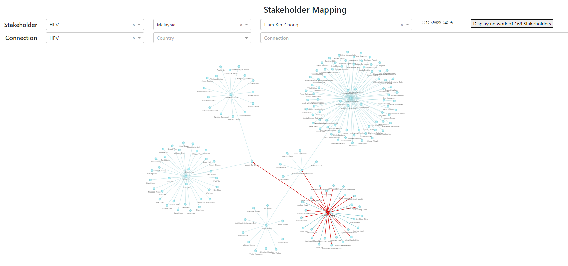
Plotly Dash Network Tool

Slide 7
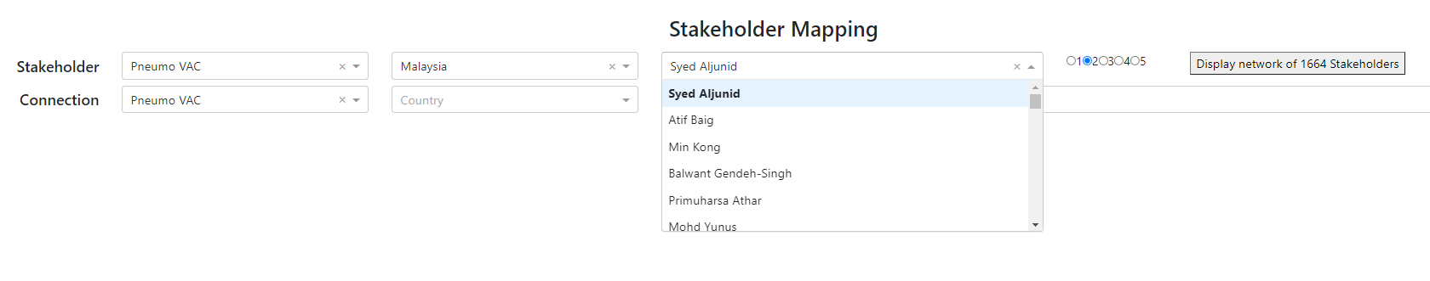
Who is at the centre of all connections for Pneumo VAC in Malaysia?
1
2
3
Select Pneumo VAC as therapeutic area.
Select Malaysia as country.
View drop-down list of Stakeholders. It is sorted from most influential Stakeholder to least.
Answer:
Syed Aljunid is the Stakeholder with the most connections in Pneumo VAC in Malaysia.
(ie. he is the centre of all connections).
He has 1664 connections within 2 degrees of separation from him.

Slide 8
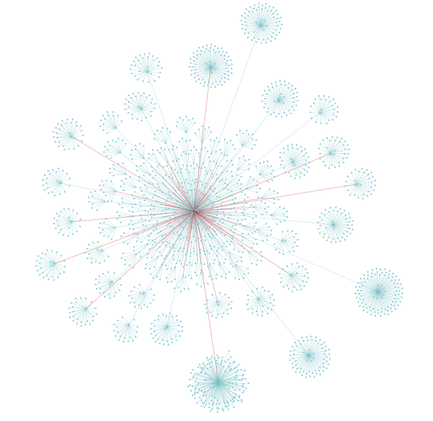
Who is Syed Aljunid influencing up to 2 degrees within Pneumo VAC?
1
2
3
4
Pneumo VAC is auto-selected as therapeutic area for Connections (can be changed manually)
Select Syed Aljunid as Stakeholder.
Select 2 degrees of connection.
Click on Display Network of 1664 Stakeholders.
Syed Aljunid is the center red node of the network.
Other stakeholders connected to Syed Aljunid who are center of influences of other groups can also be identified.
Zoom in to see the names of each of the stakeholder.

Slide 9
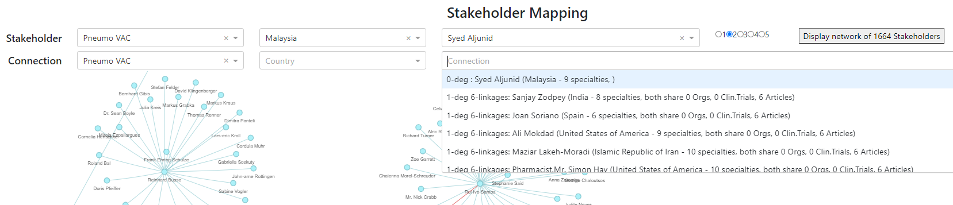
How do we get to Syed Aljunid if we can’t reach him directly?
Select the Connection dropdown to see a list of Stakeholders who are connected to Syed Aljunid. The list is sorted from the strongest to weakest connection to the Syed Aljunid.
Eg: Sanjay Zodpey from India is the strongest connection to Syed Aljunid. He is a 1st degree connection and together they share 6 linkages in the form of Articles.
(Additional information - Zodpey is in a total of 8 different specialties/therapeutic areas)

Slide 10
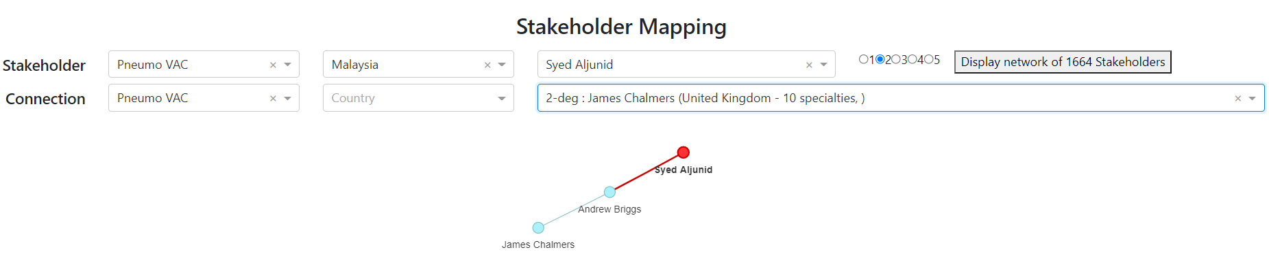
James Chalmers is our known Connection. Can we reach Syed Aljunid via him?
Type in James Chalmers into the Connections field to quickly search if he is connected to Syed Aljunid.
Answer: James Chalmers is connected to Syed Aljunid but only as a 2nd degree connection, via Andrew Briggs.

Slide 11
User Tips
The Network Graph and Connection DropDowns are anchored to the Selected Stakeholder (Syed Aljunid), and their depth depends on the Selected Degree of Separation.

